Slide 1


Thar Institute OF Engineering Science and Technology
NED University of Engineering and Technology
MT-272 Linear Algebra & Geometry
Mr. Pirbhu Lal
Lecturer (Visiting Faculty)
MS- Applied Mathematics

Slide 2
Matrix
Matrix, a set of numbers arranged in rows and columns so as to form a rectangular array. The numbers are called the elements, or entries, of the matrix.
Matrices have wide applications in engineering, physics, economics, and statistics as well as in various branches of mathematics. Matrices also have important applications in computer graphics, where they have been used to represent rotations and other transformations of images.

Slide 3
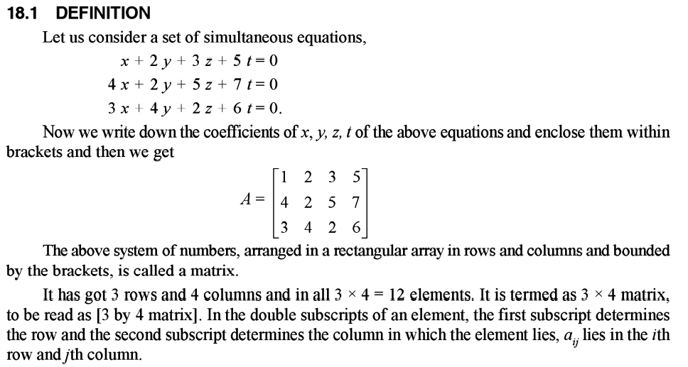

Slide 4
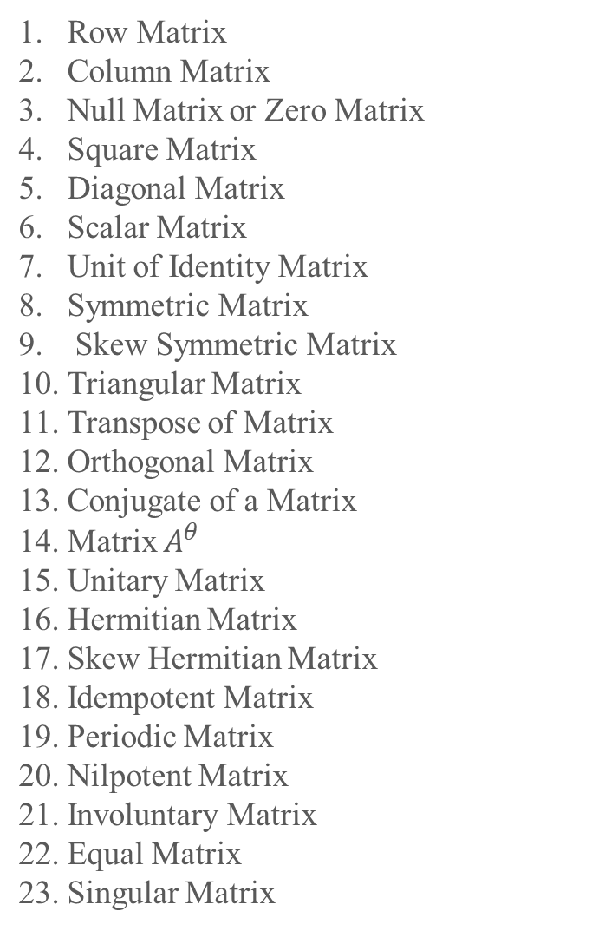
Row Matrix
Column Matrix
Null Matrix or Zero Matrix
Square Matrix
Diagonal Matrix
Scalar Matrix
Unit of Identity Matrix
Symmetric Matrix
Skew Symmetric Matrix
Triangular Matrix
Transpose of Matrix
Orthogonal Matrix
Conjugate of a Matrix
Matrix $A^{θ}$
Unitary Matrix
Hermitian Matrix
Skew Hermitian Matrix
Idempotent Matrix
Periodic Matrix
Nilpotent Matrix
Involuntary Matrix
Equal Matrix
Singular Matrix
Various Types of Matrix:

Slide 5
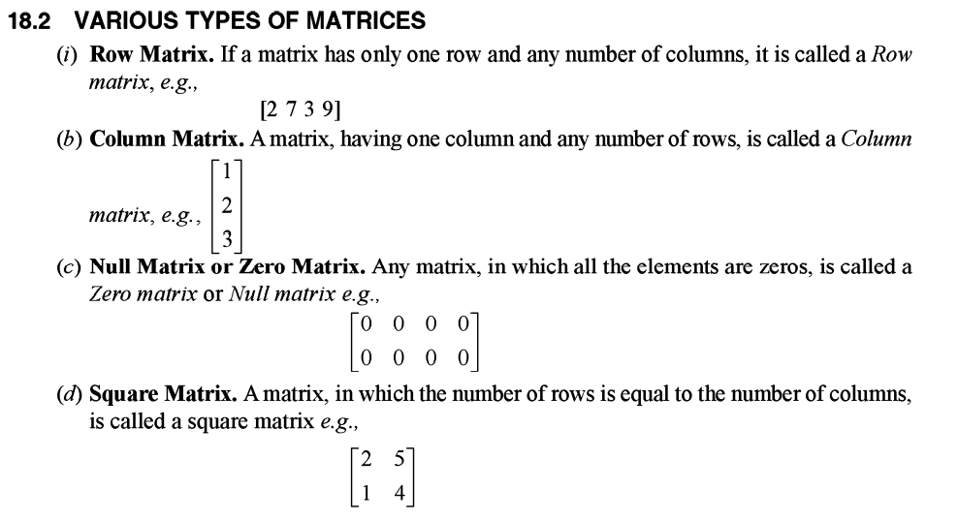

Slide 6
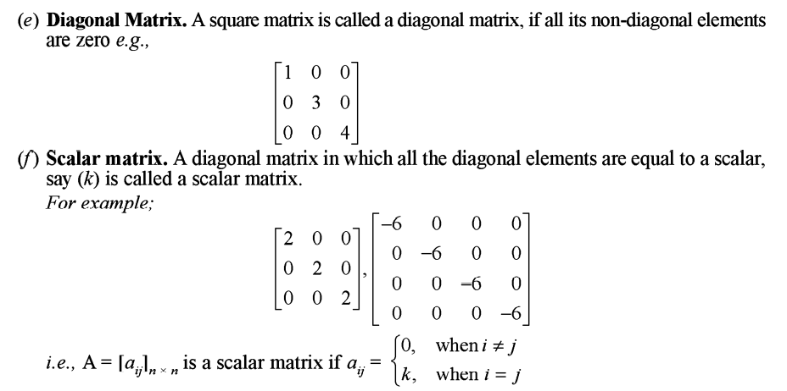

Slide 7
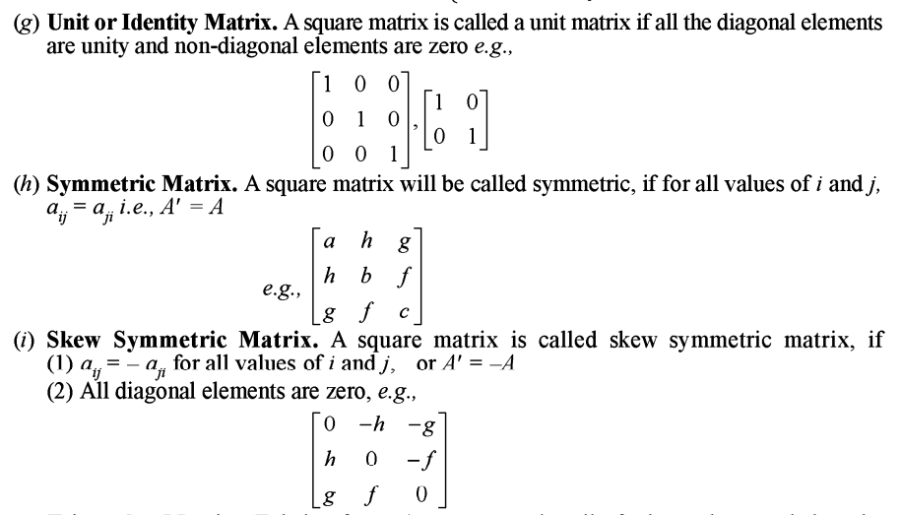

Slide 8
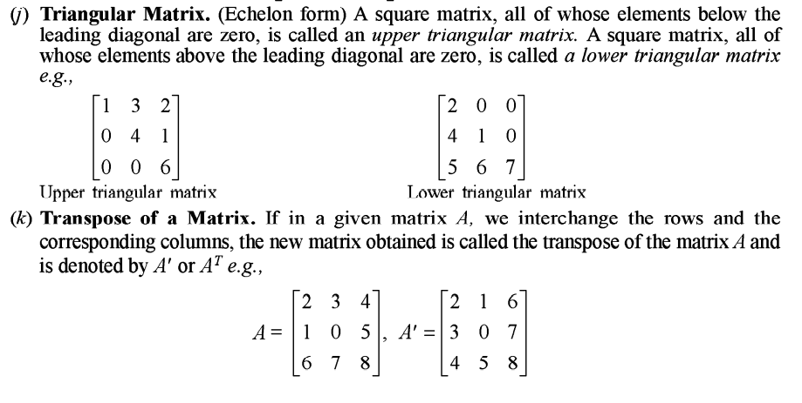

Slide 9
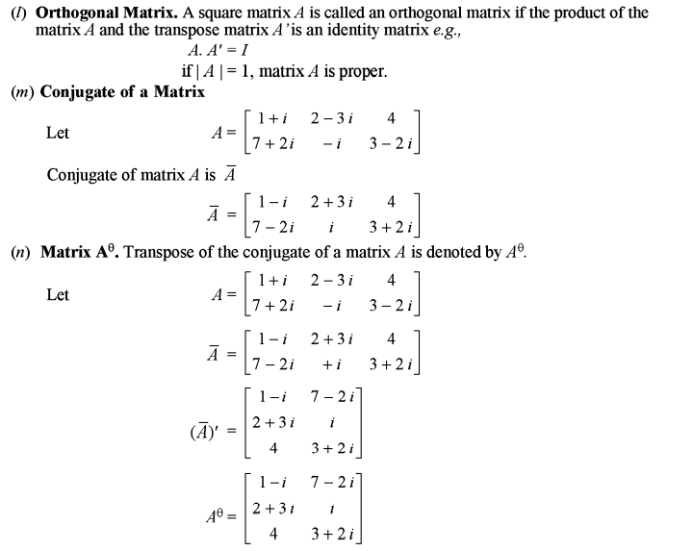

Slide 10
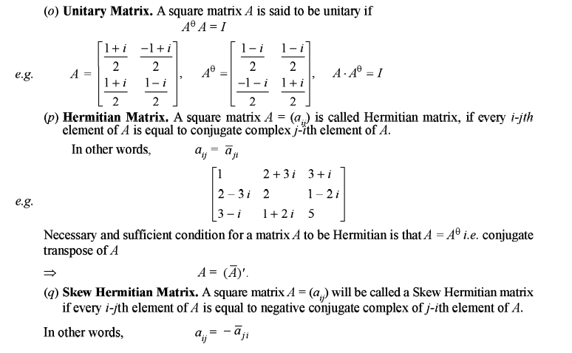

Slide 11
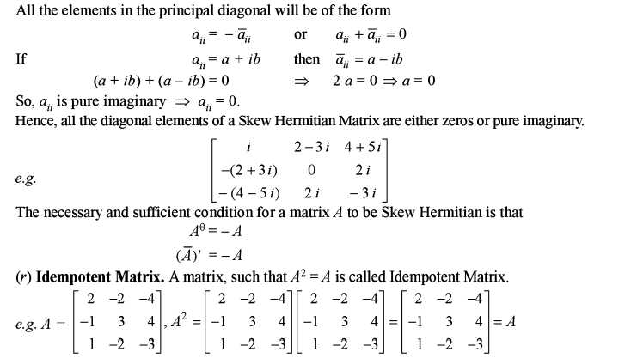

Slide 12
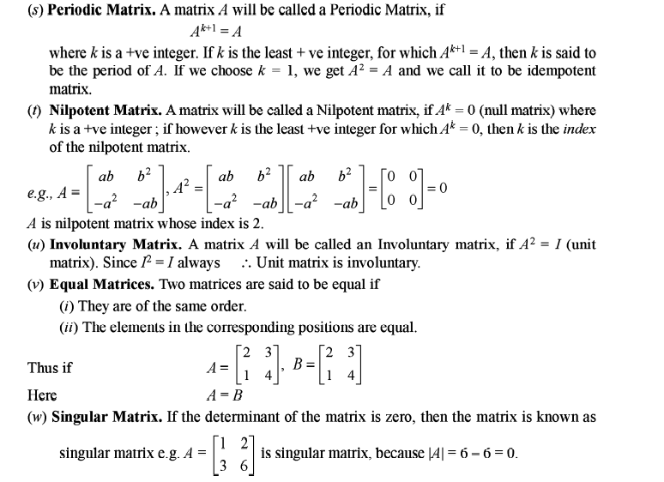

Slide 13
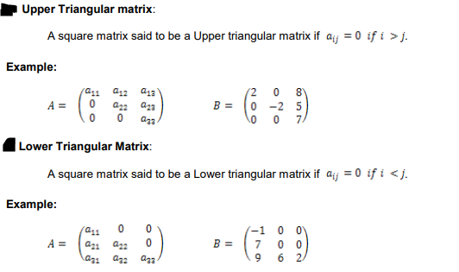

Slide 14
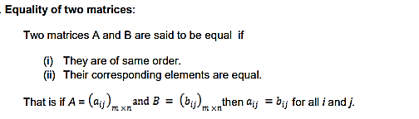

Slide 15
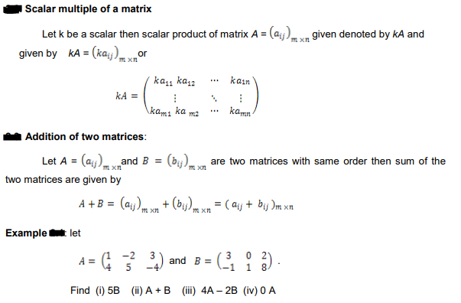

Slide 16
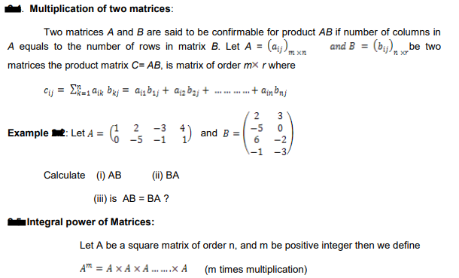

Slide 17

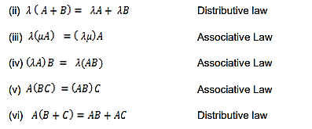

Slide 18
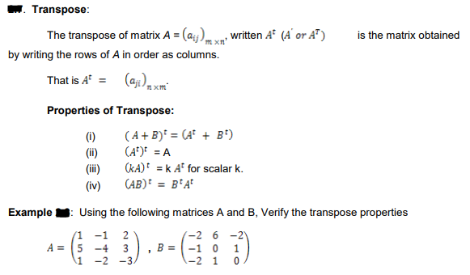
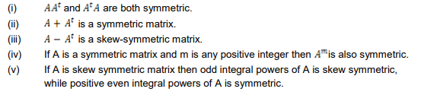

Slide 19
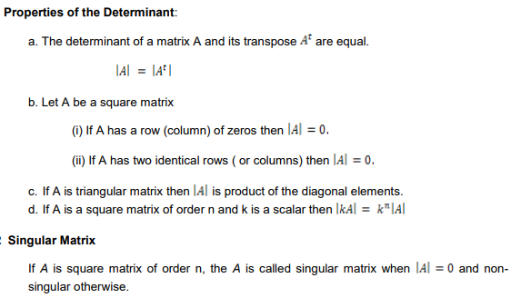

Slide 20
Using Row Operations to Find (1/3)
Find the inverse of
Solution:
  To accomplish this we shall adjoin the identity matrix to the right side of A, thereby producing a matrix of the form
  we shall apply row operations to this matrix until the left side is reduced to I ;these operations will convert the right side to, so that the final matrix will have the form

Slide 21
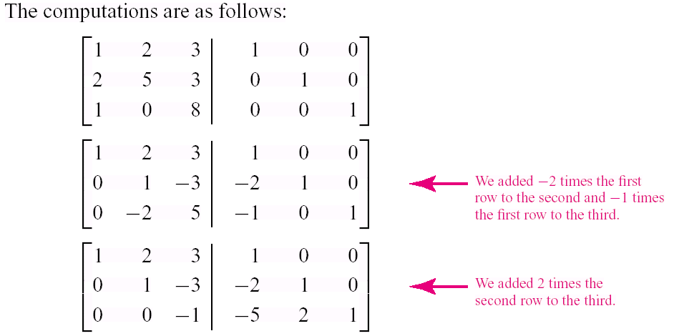
Using Row Operations to Find (2/3)

Slide 22
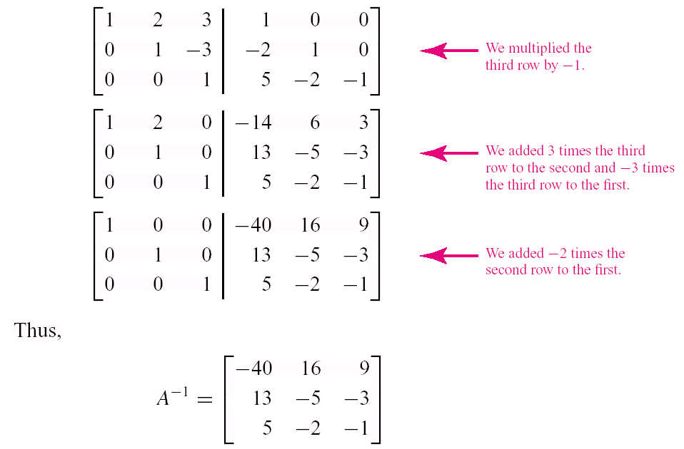
Example4
Using Row Operations to Find (3/3)

Slide 23
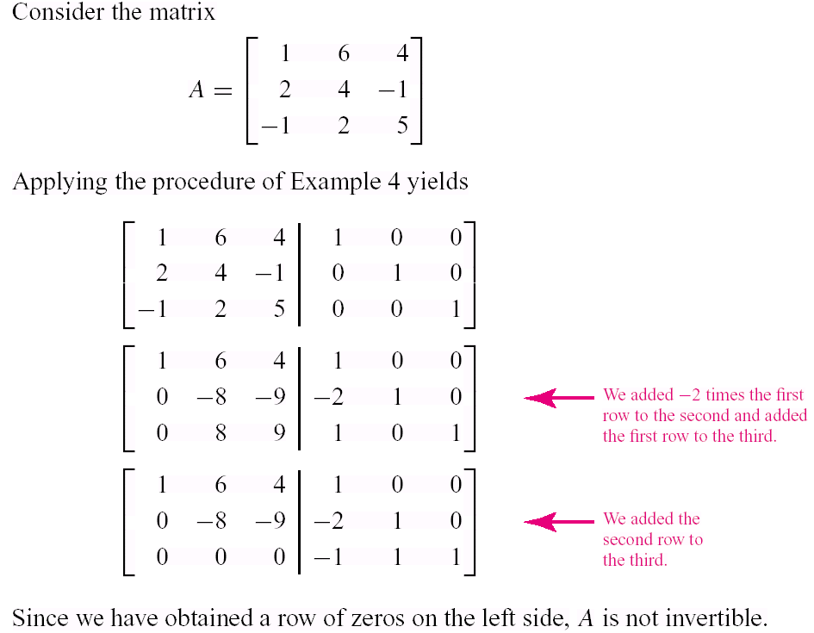
Showing That a Matrix Is Not Invertible

Slide 24
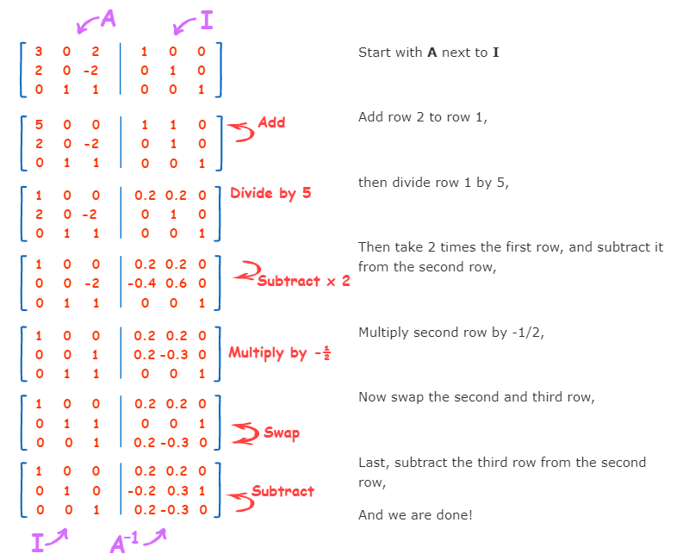

Slide 25
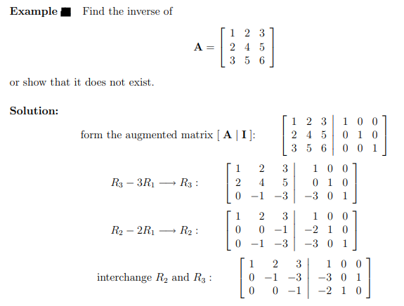

Slide 26
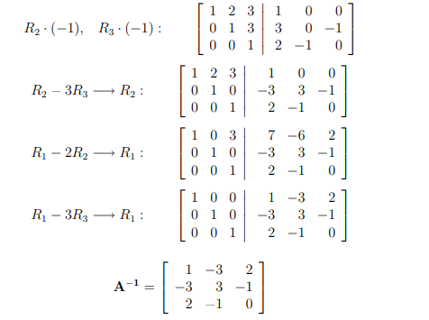

Slide 27
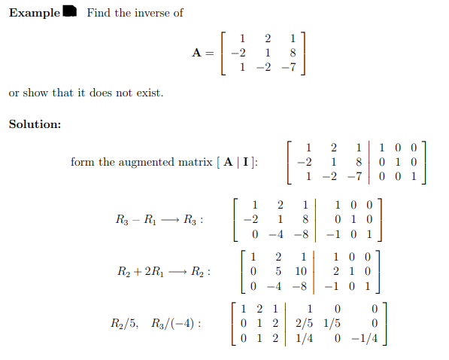
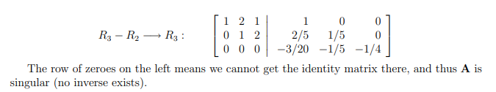

Slide 28
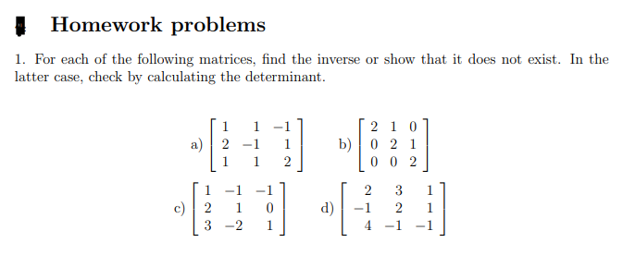

Slide 29
Linear Equations in Linear Algebra
Row Reduction and Echelon Forms

Slide 30
ECHELON FORM
A rectangular matrix is in echelon form (or row echelon form) if it has the following three properties:
    All nonzero rows are above any rows of all zeros.
    Each leading entry of a row is in a column to the right of the leading entry of the row above it.
    All entries in a column below a leading entry are zeros.

Slide 31
Example of matrix in Echelon Form
Matrix in Echelon form

Slide 32
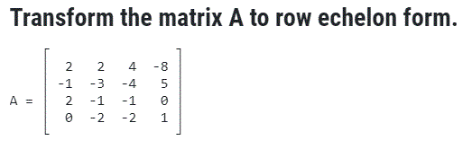
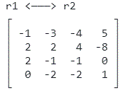
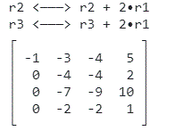
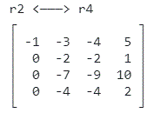
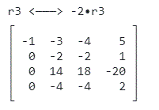
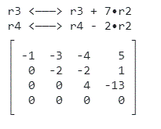
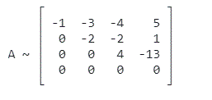

Slide 33
ECHELON FORM
If a matrix in echelon form satisfies the following additional conditions, then it is in reduced echelon form (or reduced row echelon form):
  4. The leading entry in each nonzero row is 1.
  5. Each leading 1 is the only nonzero entry in its column.
An echelon matrix (respectively, reduced echelon matrix) is one that is in echelon form (respectively, reduced echelon form.)

Slide 34
Example of matrix in Echelon Form
Matrix in Echelon form

Slide 35
ECHELON FORM
Any nonzero matrix may be row reduced (i.e., transformed by elementary row operations) into more than one matrix in echelon form, using different sequences of row operations. However, the reduced echelon form one obtains from a matrix is unique.
Theorem 1: Uniqueness of the Reduced Echelon Form
Each matrix is row equivalent to one and only one reduced echelon matrix.

Slide 36
PIVOT POSITION
If a matrix A is row equivalent to an echelon matrix U, we call U an echelon form (or row echelon form) of A; if U is in reduced echelon form, we call U the reduced echelon form of A.
A pivot position in a matrix A is a location in A that corresponds to a leading 1 in the reduced echelon form of A. A pivot column is a column of A that contains a pivot position.

Slide 37
PIVOT POSITION
Example 1: Row reduce the matrix A below to echelon form, and locate the pivot columns of A.
Solution: The top of the leftmost nonzero column is the first pivot position. A nonzero entry, or pivot, must be placed in this position.

Slide 38
PIVOT POSITION
Now, interchange rows 1 and 4.
Create zeros below the pivot, 1, by adding multiples of the first row to the rows below, and obtain the next matrix.
Pivot
Pivot column

Slide 39
PIVOT POSITION
Choose 2 in the second row as the next pivot.
Add times row 2 to row 3, and add times row 2 to row 4.
Pivot
Next pivot column

Slide 40
PIVOT POSITION
There is no way a leading entry can be created in column 3. But, if we interchange rows 3 and 4, we can produce a leading entry in column 4.

Slide 41
PIVOT POSITION
Pivot
Pivot columns
The matrix is in echelon form and thus reveals that columns 1, 2, and 4 of A are pivot columns.
The pivots in the example are 1, 2 and -5.

Slide 42
ROW REDUCTION ALGORITHM
Example 2: Apply elementary row operations to transform the following matrix first into echelon form and then into reduced echelon form.
Solution:
STEP 1: Begin with the leftmost nonzero column. This is a pivot column. The pivot position is at the top.

Slide 43
ROW REDUCTION ALGORITHM
STEP 2: Select a nonzero entry in the pivot column as a pivot. If necessary, interchange rows to move this entry into the pivot position.
Pivot column

Slide 44
ROW REDUCTION ALGORITHM
Interchange rows 1 and 3. (Rows 1 and 2 could have also been interchanged instead.)
STEP 3: Use row replacement operations to create zeros in all positions below the pivot.
Pivot

Slide 45
ROW REDUCTION ALGORITHM
We could have divided the top row by the pivot, 3, but with two 3s in column 1, it is just as easy to add times row 1 to row 2.
STEP 4: Cover the row containing the pivot position, and cover all rows, if any, above it. Apply steps 1–3 to the submatrix that remains. Repeat the process until there are no more nonzero rows to modify.
Pivot

Slide 46
ROW REDUCTION ALGORITHM
With row 1 covered, step 1 shows that column 2 is the next pivot column; for step 2, select as a pivot the “top” entry in that column.
For step 3, we could insert an optional step of dividing the “top” row of the submatrix by the pivot, 2. Instead, we add times the “top” row to the row below.
Pivot
New pivot column

Slide 47
ROW REDUCTION ALGORITHM
This produces the following matrix.
When we cover the row containing the second pivot position for step 4, we are left with a new submatrix that has only one row.

Slide 48
ROW REDUCTION ALGORITHM
Steps 1–3 require no work for this submatrix, and we have reached an echelon form of the full matrix. We perform one more step to obtain the reduced echelon form.
STEP 5: Beginning with the rightmost pivot and working upward and to the left, create zeros above each pivot. If a pivot is not 1, make it 1 by a scaling operation.
The rightmost pivot is in row 3. Create zeros above it, adding suitable multiples of row 3 to rows 2 and 1.

Slide 49
ROW REDUCTION ALGORITHM
The next pivot is in row 2. Scale this row, dividing by the pivot.

Slide 50
ROW REDUCTION ALGORITHM
Create a zero in column 2 by adding 9 times row 2 to row 1.
Finally, scale row 1, dividing by the pivot, 3.

Slide 51
ROW REDUCTION ALGORITHM
This is the reduced echelon form of the original matrix.
The combination of steps 1–4 is called the forward phase of the row reduction algorithm. Step 5, which produces the unique reduced echelon form, is called the backward phase.

Slide 52
SOLUTIONS OF LINEAR SYSTEMS
The row reduction algorithm leads to an explicit description of the solution set of a linear system when the algorithm is applied to the augmented matrix of the system.
Suppose that the augmented matrix of a linear system has been changed into the equivalent reduced echelon form.

Slide 53
SOLUTIONS OF LINEAR SYSTEMS
There are 3 variables because the augmented matrix has four columns. The associated system of equations is
----(1)
The variables x₁ and x₂ corresponding to pivot columns in the matrix are called basic variables. The other variable, x₃, is called a free variable.

Slide 54
SOLUTIONS OF LINEAR SYSTEMS
Whenever a system is consistent, as in (1), the solution set can be described explicitly by solving the reduced system of equations for the basic variables in terms of the free variables.
This operation is possible because the reduced echelon form places each basic variable in one and only one equation.
In (1), solve the first and second equations for x₁ and x₂. (Ignore the third equation; it offers no restriction on the variables.)

Slide 55
SOLUTIONS OF LINEAR SYSTEMS
----(2)
The statement “x₃ is free” means that you are free to choose any value for x₃. Once that is done, the formulas in (2) determine the values for x₁ and x₂. For instance, when , the solution is (1,4,0); when , the solution is (6,3,1).
Each different choice of x₃ determines a (different) solution of the system, and every solution of the system is determined by a choice of x₃.

Slide 56
PARAMETRIC DESCRIPTIONS OF SOLUTION SETS
The description in (2) is a parametric description of solutions sets in which the free variables act as parameters.
Solving a system amounts to finding a parametric description of the solution set or determining that the solution set is empty.
Whenever a system is consistent and has free variables, the solution set has many parametric descriptions.

Slide 57
PARAMETRIC DESCRIPTIONS OF SOLUTION SETS
For instance, in system (1), add 5 times equation 2 to equation 1 and obtain the following equivalent system.
We could treat x₂ as a parameter and solve for x₁ and x₃ in terms of x₂, and we would have an accurate description of the solution set.
When a system is inconsistent, the solution set is empty, even when the system has free variables. In this case, the solution set has no parametric representation.

Slide 58
EXISTENCE AND UNIQUENESS THEOREM
Theorem 2: Existence and Uniqueness Theorem
A linear system is consistent if and only if the rightmost column of the augmented matrix is not a pivot column—i.e., if and only if an echelon form of the augmented matrix has no row of the form
[0 … 0 b] with b nonzero.
If a linear system is consistent, then the solution set contains either (i) a unique solution, when there are no free variables, or (ii) infinitely many solutions, when there is at least on free variable.

Slide 59
ROW REDUCTION TO SOLVE A LINEAR SYSTEM
Using Row Reduction to Solve a Linear System
    Write the augmented matrix of the system.
    Use the row reduction algorithm to obtain an equivalent augmented matrix in echelon form. Decide whether the system is consistent. If there is no solution, stop; otherwise, go to the next step.
    Continue row reduction to obtain the reduced echelon form.
    Write the system of equations corresponding to the matrix obtained in step 3.
    Rewrite each nonzero equation from step 4 so that its one basic variable is expressed in terms of any free variables appearing in the equation.

Slide 60
Computation of Eigenvalues and Eigenvectors
Let A be an n × n matrix with eigenvalue λ and corresponding eigenvector x. Thus Ax = λx. This equation may be written
Ax – λx = 0
given
(A – λI_{n})x = 0
Solving the equation |A – λI_{n}| = 0 for λ leads to all the eigenvalues of A.
On expending the determinant |A – λI_{n}|, we get a polynomial in λ. This polynomial is called the characteristic polynomial of A.
The equation |A – λI_{n}| = 0 is called the characteristic equation of A.

Slide 61
Example 1
Find the eigenvalues and eigenvectors of the matrix
Solution
Let us first derive the characteristic polynomial of A.
We get
We now solve the characteristic equation of A.
The eigenvalues of A are 2 and –1.
The corresponding eigenvectors are found by using these values of λ in the equation(A – λI₂)x = 0. There are many eigenvectors corresponding to each eigenvalue.

Slide 62
For λ = 2
We solve the equation (A – 2I₂)x = 0 for x.
The matrix (A – 2I₂) is obtained by subtracting 2 from the diagonal elements of A. We get
This leads to the system of equations
giving x₁ = –x₂. The solutions to this system of equations are x₁ = –r, x₂ = r, where r is a scalar. Thus the eigenvectors of A corresponding to λ = 2 are nonzero vectors of the form

Slide 63
For λ = –1
We solve the equation (A + 1I₂)x = 0 for x.
The matrix (A + 1I₂) is obtained by adding 1 to the diagonal elements of A. We get
This leads to the system of equations
Thus x₁ = –2x₂. The solutions to this system of equations are x₁ = –2s and x₂ = s, where s is a scalar. Thus the eigenvectors of A corresponding to λ = –1 are nonzero vectors of the form

Slide 64
Example 2
Find the eigenvalues and eigenvectors of the matrix
Solution
The matrix A – λI₃ is obtained by subtracting λ from the diagonal elements of A.Thus
The characteristic polynomial of A is |A – λI₃|. Using row and column operations to simplify determinants, we get

Slide 65
We now solving the characteristic equation of A:
The eigenvalues of A are 10 and 1.
The corresponding eigenvectors are found by using three values of λ in the equation (A – λI₃)x = 0.

Slide 66
λ₁ = 10
We get
The solution to this system of equations are x₁ = 2r, x₂ = 2r, and x₃ = r, where r is a scalar.
Thus the eigenspace of λ₁ = 10 is the one-dimensional space of vectors of the form.

Slide 67
λ₂ = 1
Let λ = 1 in (A – λI₃)x = 0. We get
The solution to this system of equations can be shown to be x₁ = – s – t, x₂ = s, and x₃ = 2t, where s and t are scalars. Thus the eigenspace of λ₂ = 1 is the space of vectors of the form.

Slide 68
Separating the parameters s and t, we can write
Thus the eigenspace of λ = 1 is a two-dimensional subspace of R³ with basis
If an eigenvalue occurs as a k times repeated root of the
characteristic equation, we say that it is of multiplicity k.
Thus λ=10 has multiplicity 1, while λ=1 has multiplicity 2
in this example.

Slide 69
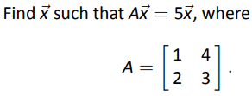

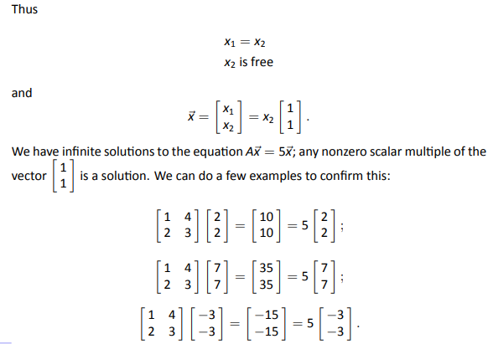
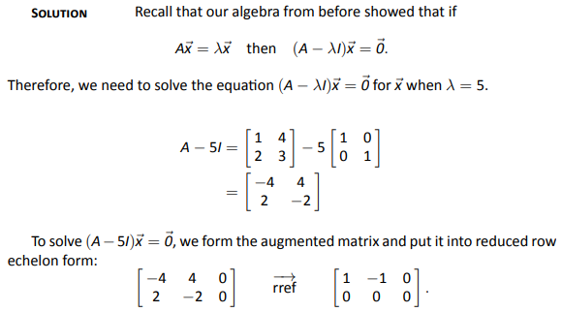
Problem
Solution

